Slide 1
Handle unlock code request from outlook for Engineering/Telco Operator created with UiPath RPA designer/orchestrator
Terry Lee

Slide 2
Disclaimer
This file does not contain any sensitive corporate data, specific process details, or information pertaining to any particular organization or individuals. Its purpose is to offer a high-level view of the generic steps taken by the authors to address a specific business problem. It serves as a scalable and adaptable template, enabling the replication of these steps for solving similar problems in future. Additionally, it includes technical details that can be partially or entirely reused for ongoing learning and improvement in future projects.

Slide 3
Business problem: The agents of network operators request unlock code to manufacturer via email to deal with end customer requests. The requests arrive daily with all different formats, and the code look up involves going through approval to receive data from company database system in headquarter residing overseas.
The process of receiving the requests of disparate forms from multiple agents, compiling them in a single file and request to offshore team and wait for their response consume time and effort.
Solution: The generic process including steps: retrieve emails via outlook, extract product number using regex from email body, store them in excel file to manage available/unavailable codes, can be automated using Robotic Process Automation with unattended mode eliminating human involvement when applicable. If available, building internal SQL database with querying via Python to minimize the dependency and delay from requesting overseas team can be an option.

Slide 4
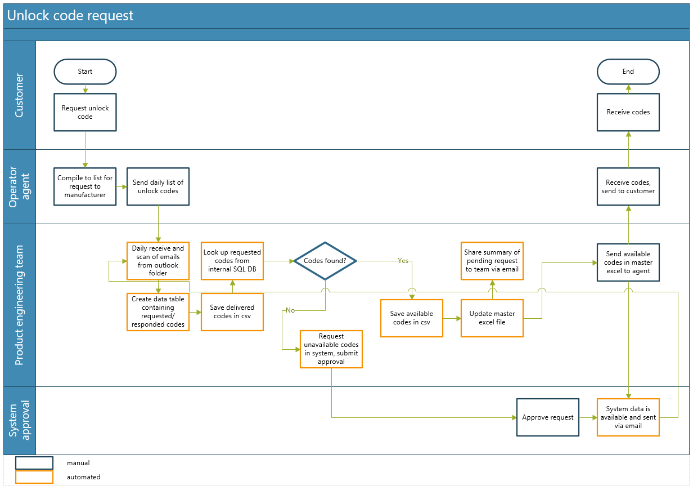

Slide 5
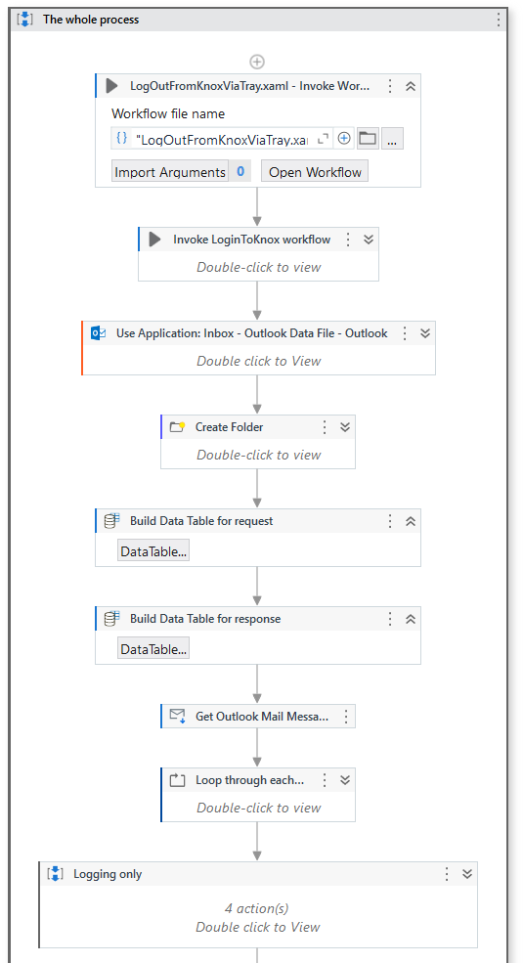
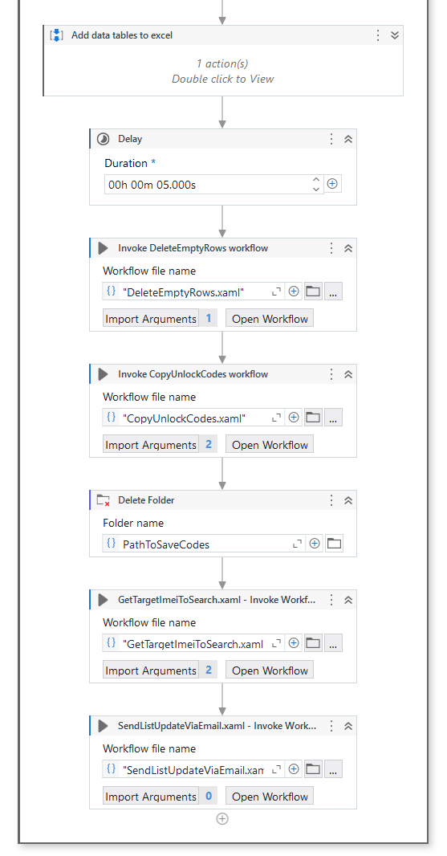
Overall steps proposed
Sequence to view [3]
Summary of automated steps
1. Login to corp portal
2. Open outlook and receive all emails
3. Scan specific folder in outlook, turn into data table and re-arrange to subfolders
4. Append data tables to master excel file
5. Send summary via email
Schedule it as unattended run daily at 8pm including weekends (agent request can arrive 7 days / wk)
Sequence to view [1]
Sequence to view [4]
Sequence to view [2]

Slide 6
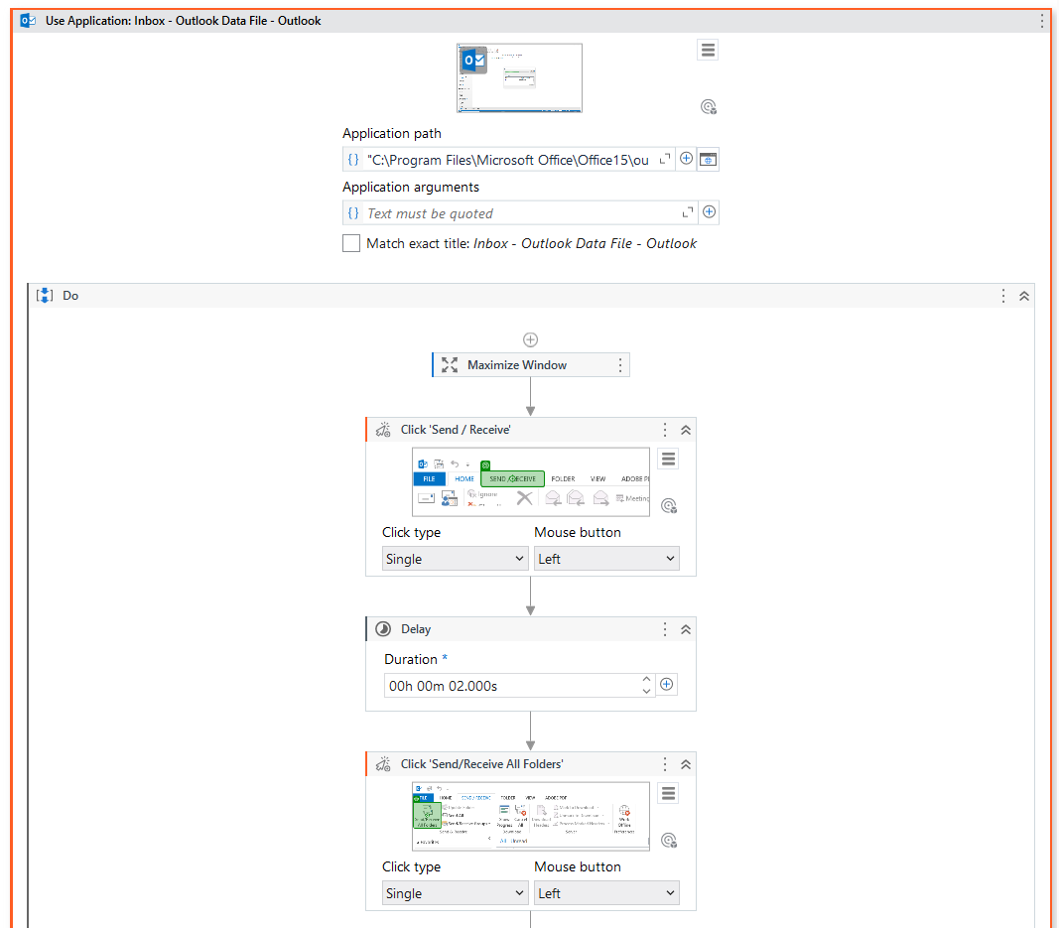
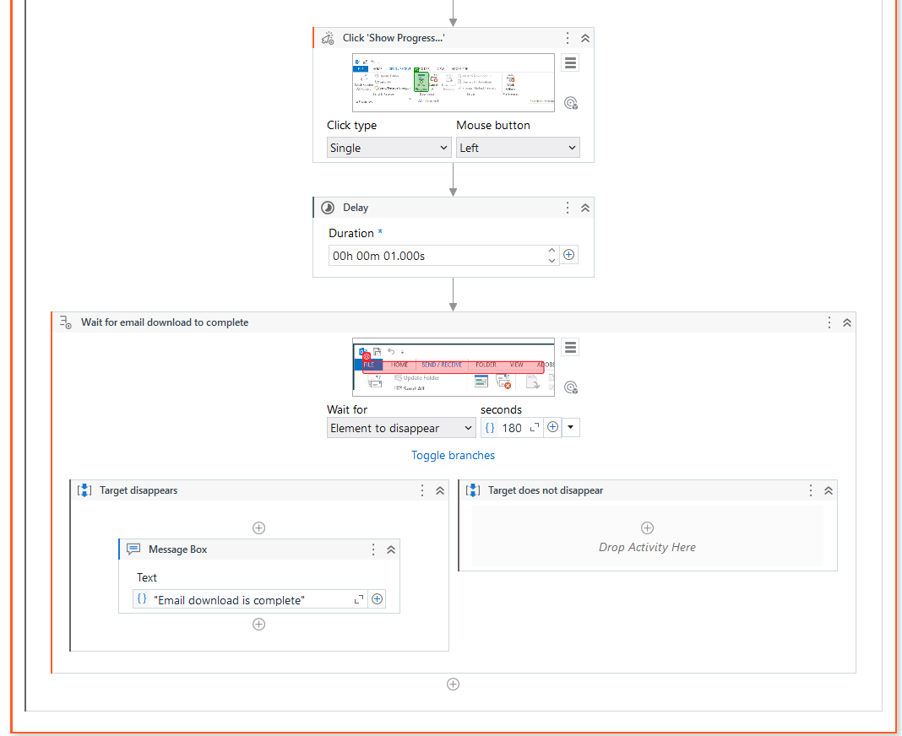
Sequence to view [1] – Open Outlook to retrieve emails

Slide 7
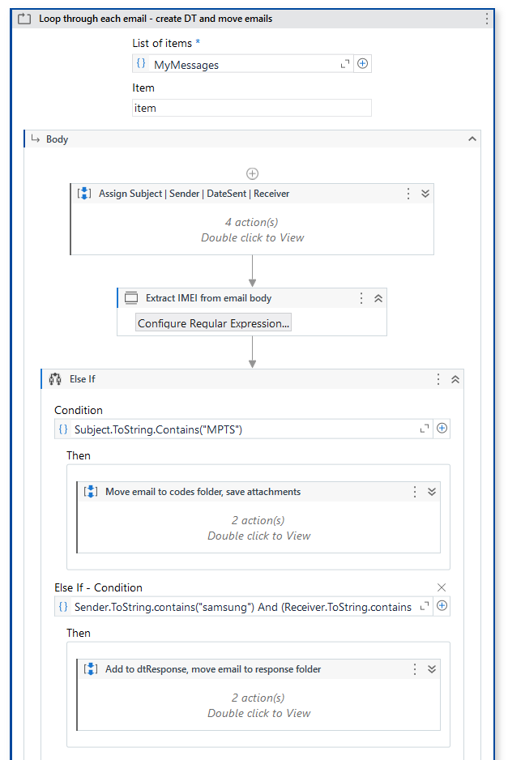
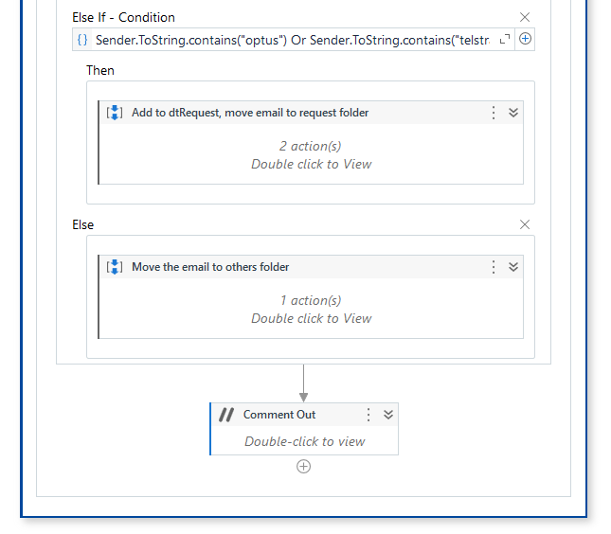
Sequence to view [2] – Loop through each email
User regular expression to extract all 15 digits serial number from email body
Input: item.body
Pattern: "\D(\d{15})\D“
Result: strExtracted
Sequence to view [2-1]

Slide 8
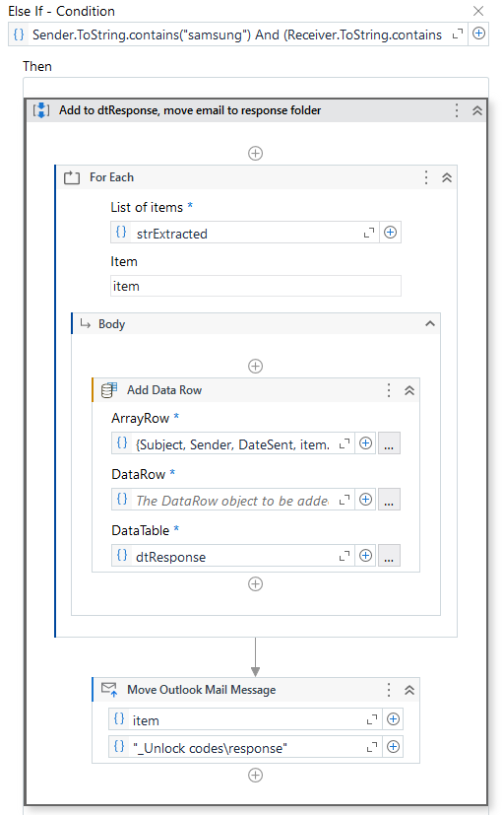
Sequence to view [2-1] – Add to Data table, move folder
Input
ArrayRow: {Subject, Sender, DateSent, item.ToString.Trim()}

Slide 9
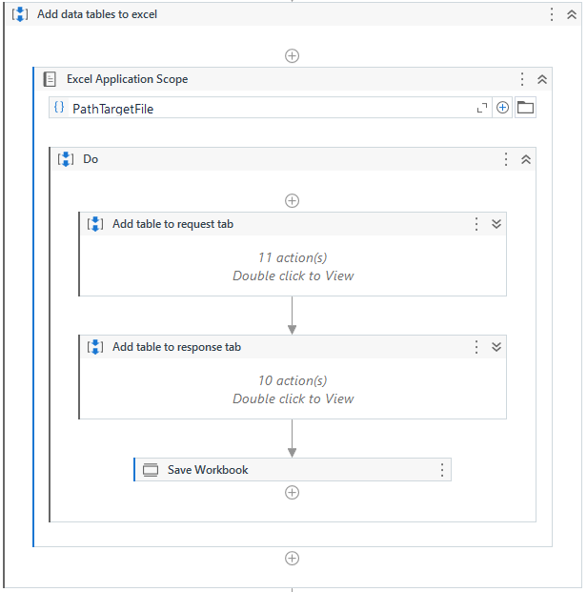
Sequence to view [3] – Add Data tables to excel
Sequence to view [3-1]

Slide 10
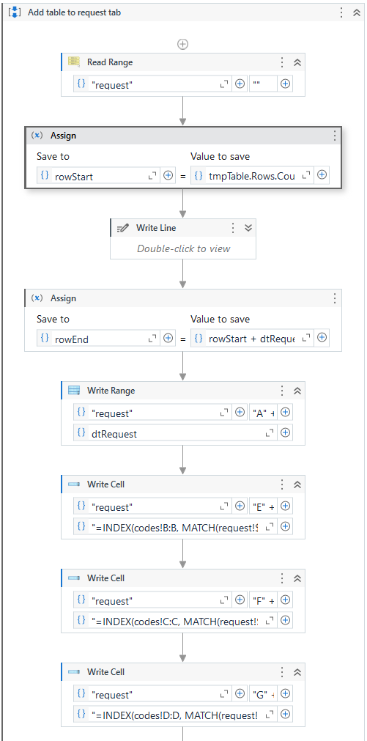
Sequence to view [3-1] – Add a single Data table to excel
rowStart: tmpTable.Rows.Count + 1
rowEnd: rowStart + dtRequest.Rows.Count -1
startingCell: "A" + rowStart.ToString
DataTable: dtRequest

Slide 11
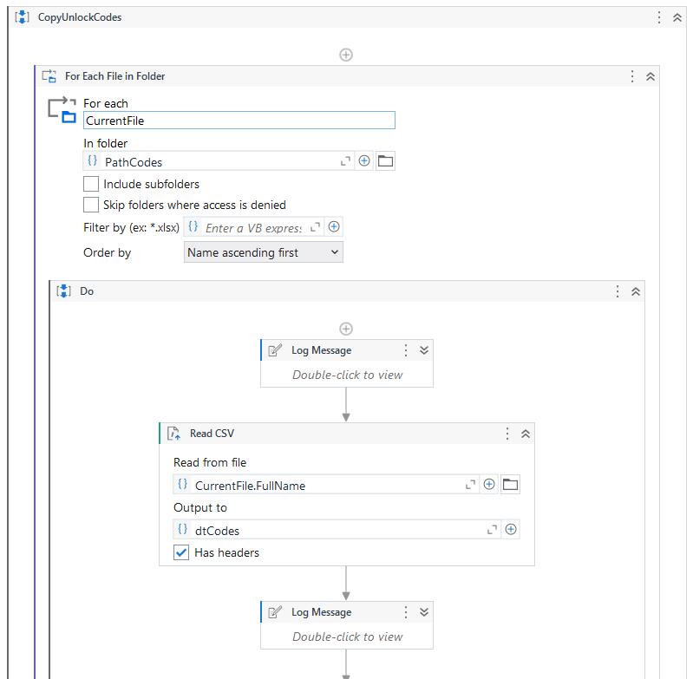
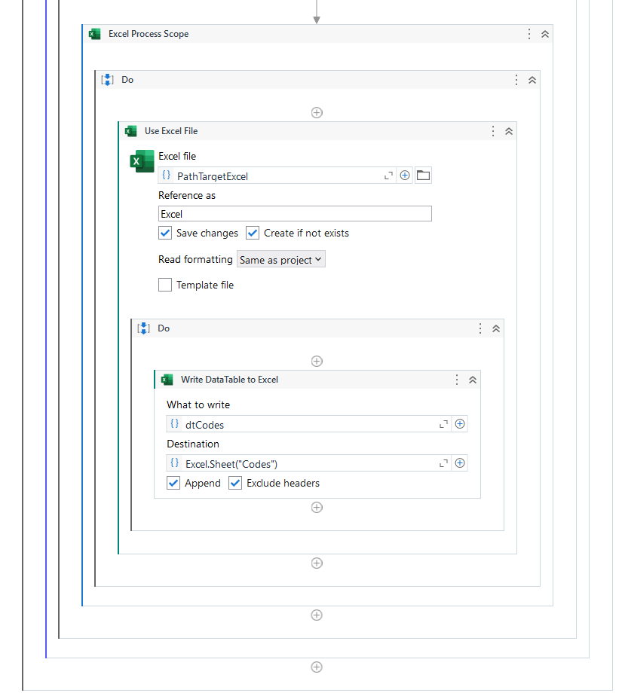
Sequence to view [4] – Copy unlock codes (in CSV) to excel

